Slide 1
Validity
Gale Lucas
lucas@ict.usc.edu

Slide 2
Today’s Topics
Consuming statistical results
Ensuring internal validity
Data lifecycle

Slide 3
Consuming statistical results

Slide 4
Tips for Consuming Statistics
Rather than focusing on whether a test is significant, focus on what the results mean and effect size.
Check to see if the author’s conclusions are supported by the data
Don’t take their word for it!

Slide 5
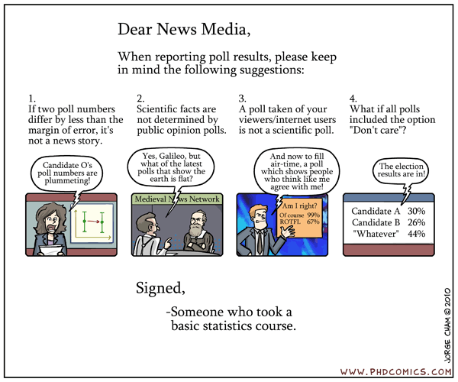

Slide 6
Tips for Consuming Statistics
Often results are misrepresented by the media
Usually, if there report a correlation or some ineffable characteristic (e.g., birth order) causes some effect, they got it wrong
Reporting a correlation could mean the variable causes an effect on the other variable, but ONLY if the first variable was manipulated/experimental

Slide 7
Ensuring internal validity

Slide 8
Ensuring internal validity
Internal validity?
Random assignment to conditions that only differ on (thus manipulate) one variable
Randomly assign
Remove confounds
Why do we care?

Slide 9


Solutions in experimental research
But, are ways to help ensure internal validity
1. Control condition similar to experimental
The conditions are very much alike, helps to control for some factors (currently alone vs with others, etc)
But still might differ on more than rejection: pain, negativity, mood, anxiety…

Slide 10
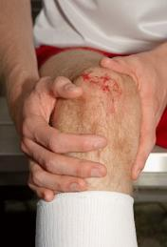

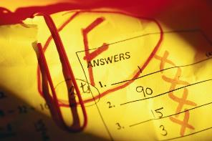
Solutions in experimental research
2. Other additional conditions that manipulate these confounds
Pain
Negativity
If they don’t increase social sensitivity but rejection condition does…
Mood?
Anxiety?

Slide 11




Solutions in experimental research
3. Measure alternative explanation
Pain
Negativity
Mood
Anxiety
If the rejection condition doesn’t increase these compared to control…
Even if it does, can control for them statistically, and if still find a difference in social sensitivity…

Slide 12




Solutions in experimental research
4. Different manipulations across studies
If always find difference…
Multiple ways to increase NTB
Reliving task
Cyberball
Living alone
Chatroom
More!
Convergent validity!

Slide 13
Solutions in experimental research
5. Combine with other ways of asking the question
Does NTB cause heightened social sensitivity?
A) NTB scores associated with sensitivity
B) Heighten need (starve) increases sensitivity
C) Reduce need (feed) decreases sensitivity?
Convergent validity!

Slide 14
Solutions in experimental research
Prime acceptance to “satiate”
Acceptance - e.g., together went us they there
Control - e.g., pretty was chair the skiing
Measure social sensitivity

Slide 15
Solutions in experimental research
6. Measure variable intended to manipulate
If experimental condition is higher on that variable…
Manipulation check
Mediation analysis
Rejection manipulation
Belonging needs
Sensitivity

Slide 16
Mediation
A variable mediates a relationship between two variables if it explains that relationship
Time spent partying Grades
Time spent partying Time spent studying Grades

Slide 17
Moderation vs. mediation
Mediator-oriented research
more interested in the mechanism of the predictor variable
when a strong relation between the predictor and the criterion variable, and one wants to explain why
Moderator research (looks for an interaction effect)
more interested in undersanding the conditons underwhich the predictor varaible exerts its influence
when there is an inconsistent (or an unexpectedly weak) relation between a predictor and a criterion variable
E.g., grit and preformance ONLY if there is passion (Jachimowicz et al., 2018)

Slide 18
Moderation
A research article says “Gender moderates the relationship between self-esteem and social network size." What does this mean?
There is an interaction - the effect of self-esteem on SNS is different depending on whether you are male or female.
Sometimes the way to talk about it is obvious (gender moderates…), sometimes it can be talked about either way
E.g., self-esteem and extraversion interact to predict life satisfaction
E.g., grit and preformance ONLY if there is passion

Slide 19
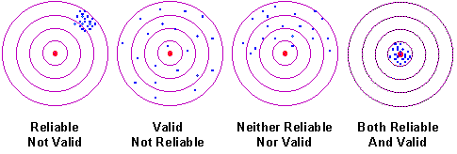
Validity vs. Reliability

Slide 20
Reliability
Test-retest reliability
Internal consistency
Notes:
With an unreliable measure, you get error, then even if you have a near perfect correlation (in reality) between two items, the observed correlation cant actually be that high. To the extent that there is error in measurement, it limits the size the correlation can be (you can actually calculate this, maximum correlation from attenuation due to unreliability
How can minimize error? Discuss …. Can control obvious errors -> clean data:::

Slide 21
Data lifecycle

Slide 22
Define questions
Pre-process data
Analyze data
Present results
Collect/find data
Store data
Extract data
Publish data

Slide 23
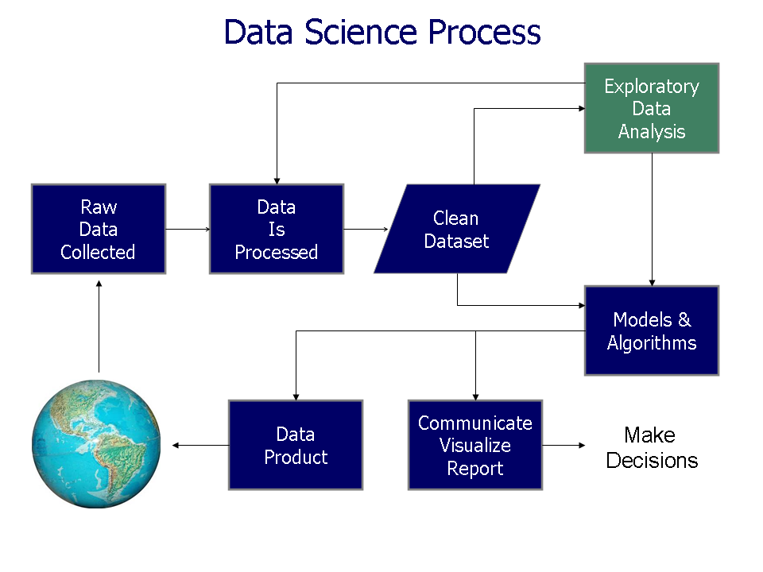
Business Analytics
Pre-process
Data
Analysis
http://upload.wikimedia.org/wikipedia/en/b/ba/Data_visualization_process_v1.png

Slide 24
The Cost of Data Preparation
“Scientists and engineers spend more than 60% of their time just preparing the data for model input or data-model comparison” (NASA A40)
“Common Motifs in Scientific Workflows: An Empirical Analysis.” Garijo, D.; Alper, P.; Belhajjame, K.; Corcho, O.; Gil, Y.; and Goble, C. Future Generation Computer Systems, 2013.

Slide 25
Define questions
Preprocess data
Analyze data
Present results
Collect/find data
Store data
Extract data
Publish data

Slide 26
Define questions
Preprocess data
Analyze data
Present results
Collect/find data
Store data
Extract data
Publish data

Slide 27
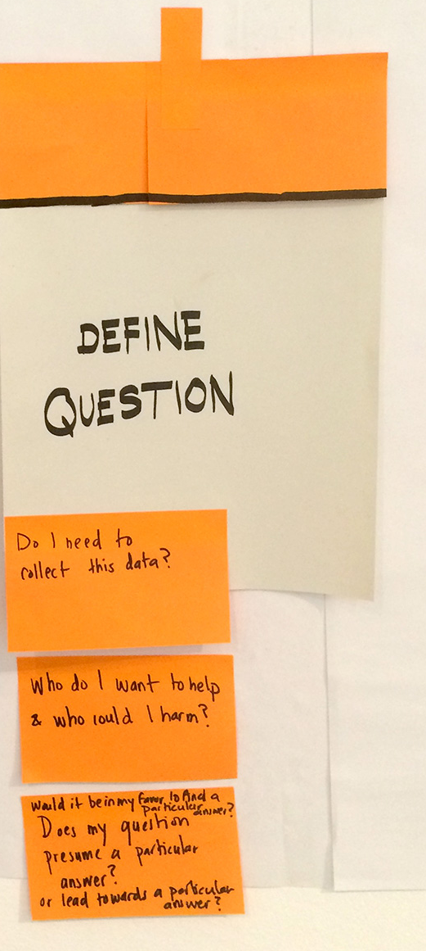
S
Utility of a question
Understand your resources
Be realistic
Prioritize
https://upload.wikimedia.org/wikipedia/commons/b/b4/The_Data_Lifecycle.jpg

Slide 28
Define questions
Preprocess data
Analyze data
Present results
Collect/find data
Store data
Extract data
Publish data
Privacy/ethics

Slide 29
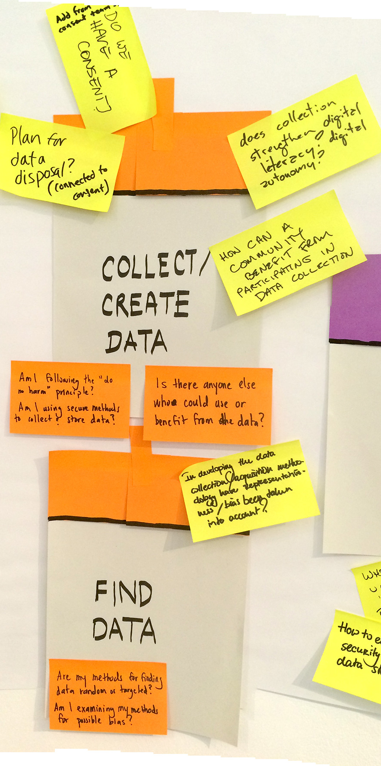
Frequency
Granularity
Cost
Takes many forms: money, time, storage, processing, effort, etc.
Utility
https://upload.wikimedia.org/wikipedia/commons/b/b4/The_Data_Lifecycle.jpg

Slide 30
Define questions
Preprocess data
Analyze data
Present results
Collect/find data
Store data
Extract data
Publish data
Privacy/ethics

Slide 31
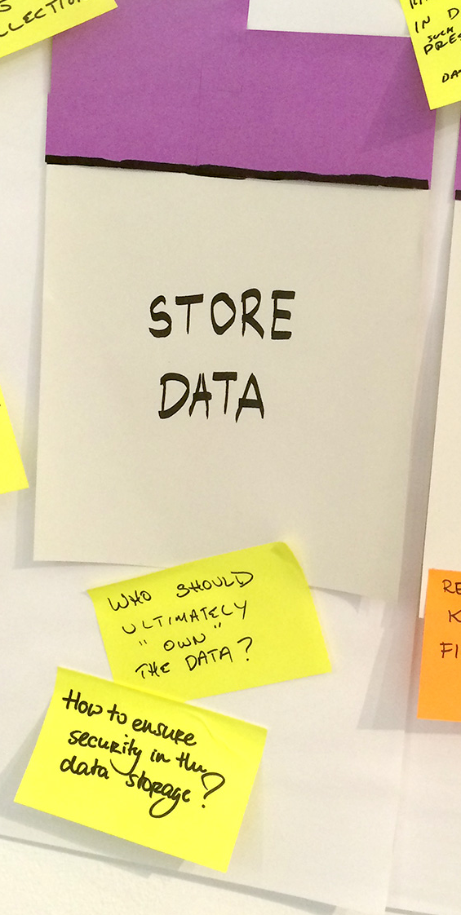
Compression vs plain
Publish/Open access
Metadata
Security
https://upload.wikimedia.org/wikipedia/commons/b/b4/The_Data_Lifecycle.jpg

Slide 32
Define questions
Preprocess data
Analyze data
Present results
Collect/find data
Store data
Extract data
Publish data

Slide 33
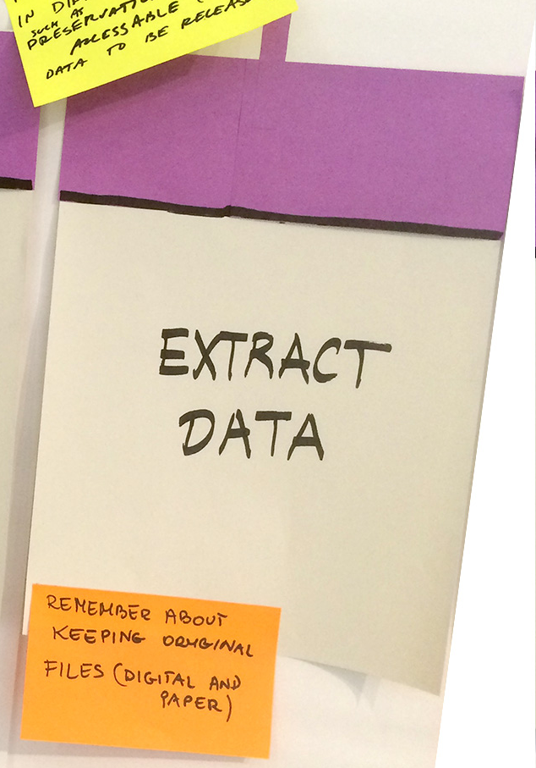
Data queries to extract useful subsets or slices of the data
https://upload.wikimedia.org/wikipedia/commons/b/b4/The_Data_Lifecycle.jpg
Notes:
If you have a database

Slide 34
Define questions
Preprocess data
Analyze data
Present results
Collect/find data
Store data
Extract data
Publish data

Slide 35
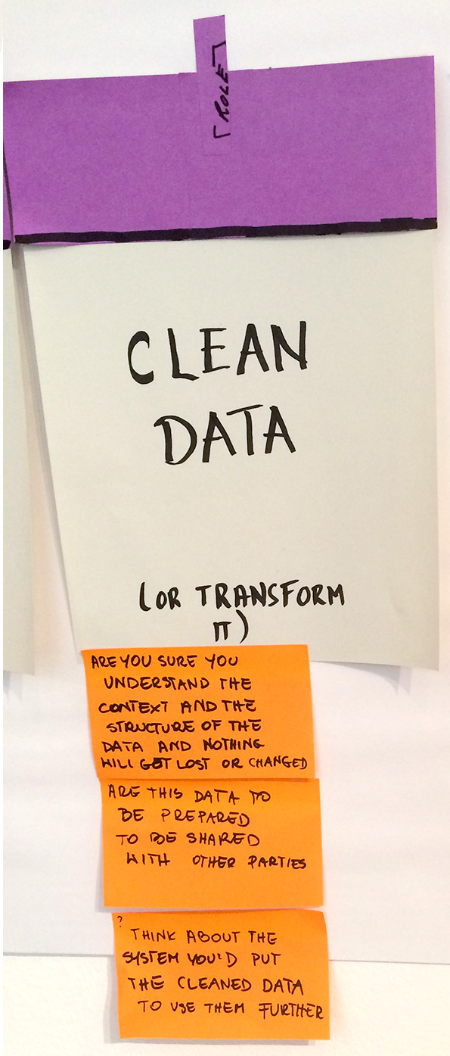
PRE-PROCESS
DATA
Reformatting
Conversion
Cleaning
Imputation
Integration
https://upload.wikimedia.org/wikipedia/commons/b/b4/The_Data_Lifecycle.jpg

Slide 36
Possible Pre-processing Steps
Data reformatting: changing the format or encoding of the data
E.g.: Changing an image from JPG to PDF
Data conversion: changing the unit of measurement or representation
E.g.: Average temperatures in different countries, data is in C and F
Data cleaning: detecting and correcting errors
E.g.: Temperature time series: 70, 68, 65, 60, 60, 60, 500, 59, 57,…
Data imputation: hypothesizing missing values
E.g.: Temperature time series: 9am 50, 10am --, 11am 60, 12pm 65
Data integration: mapping objects across datasets, merging them
E.g.: Use data from two separate social networks

Slide 37
Define questions
Preprocess data
Analyze data
Present results
Collect/find data
Store data
Extract data
Publish data

Slide 38
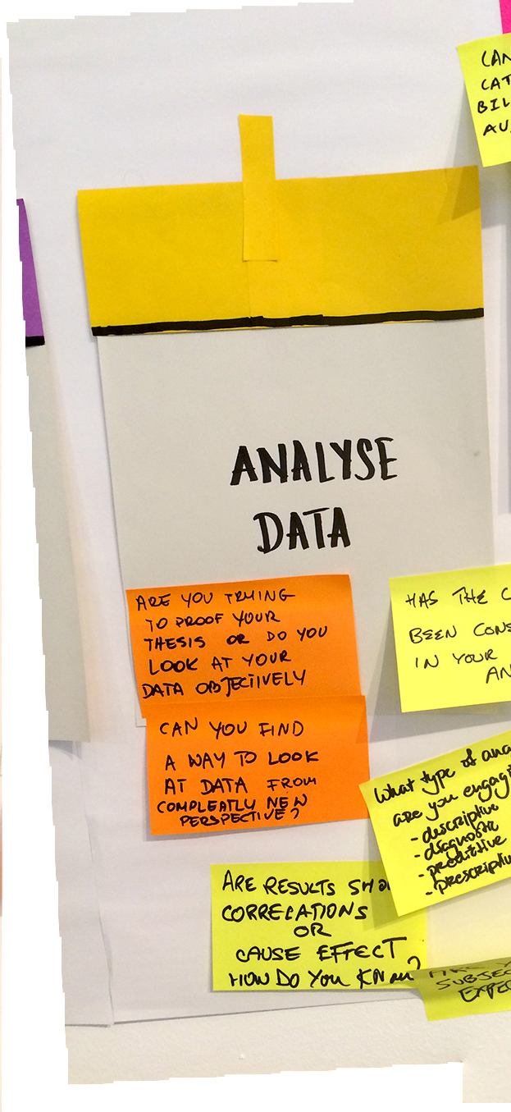
Basic statistics
Machine learning, etc.
https://upload.wikimedia.org/wikipedia/commons/b/b4/The_Data_Lifecycle.jpg

Slide 39
Define questions
Preprocess data
Analyze data
Present results
Collect/find data
Store data
Extract data
Publish data

Slide 40
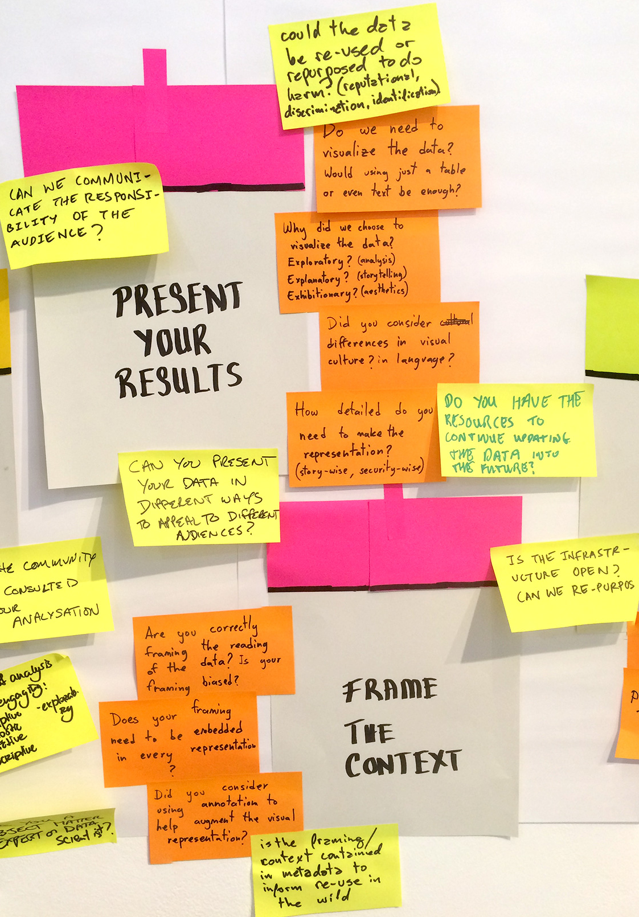
Data
visualization
Visualization
Explanation
Drill-down to details
PUBLISH
DATA
https://upload.wikimedia.org/wikipedia/commons/b/b4/The_Data_Lifecycle.jpg
Notes:
When you publish a scientific paper based on that, its also important to not just list your results, but explain them. DATA ARE, but we must interpret them as well… so provide evidence from your research (drilling down to details) and/or others to justify your explanations

Slide 41
Example of life cycle
Automatically tracked behavior in dyads

Slide 42
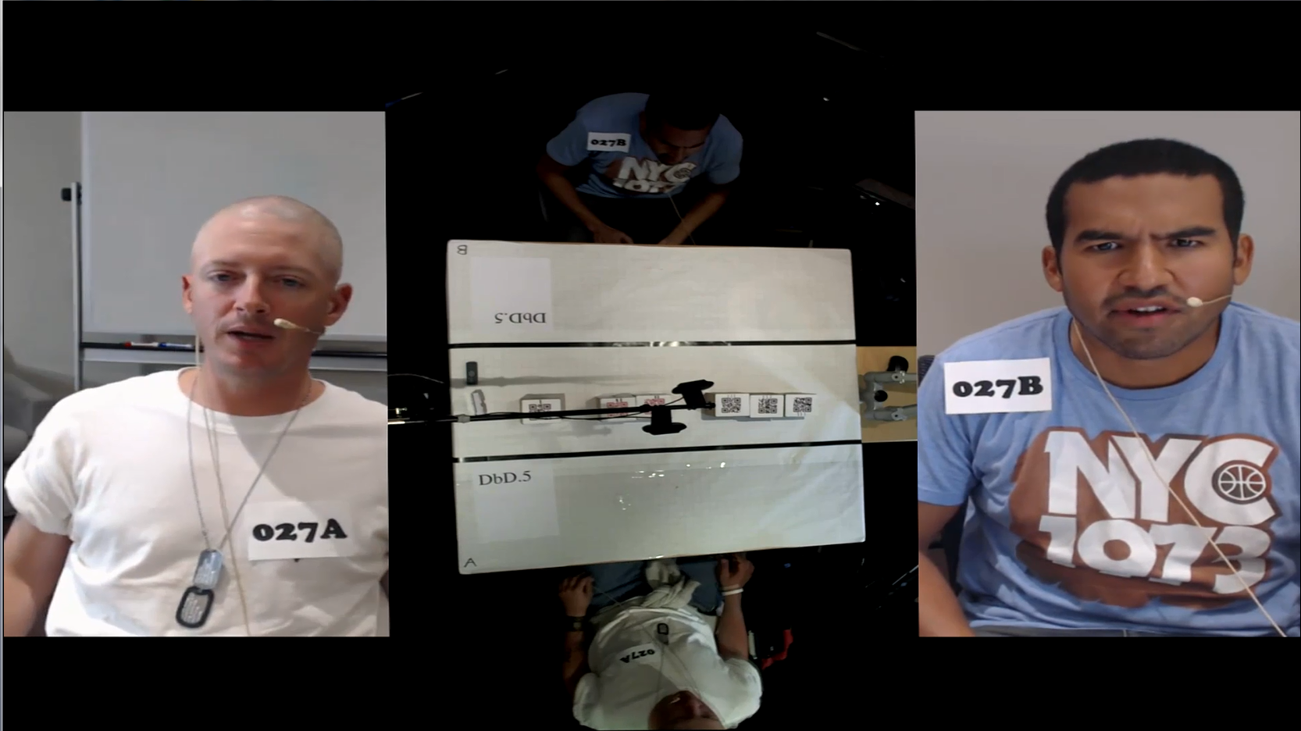
Example
Define questions

Slide 43

Example
Collect/find data

Slide 44
Example
Collected data from face-to-face dyadic negotiations
183 same-sex dyads (73 female dyads, 110 male dyads)
Video recorded
Partner’s rating of trust
Number times each lied about preferences
Videos stored on secure server
Collect/find data
Store data

Slide 45
Example
Selected relevant parts of videos
Transcribed videos
LIWC analysis provides word count
Track non-verbal behaviors
FACET: emotions, AUs
OpenFace: head, gaze
Extract data
Pre-process data
Data cleaning
Data imputation
Data integration

Slide 46
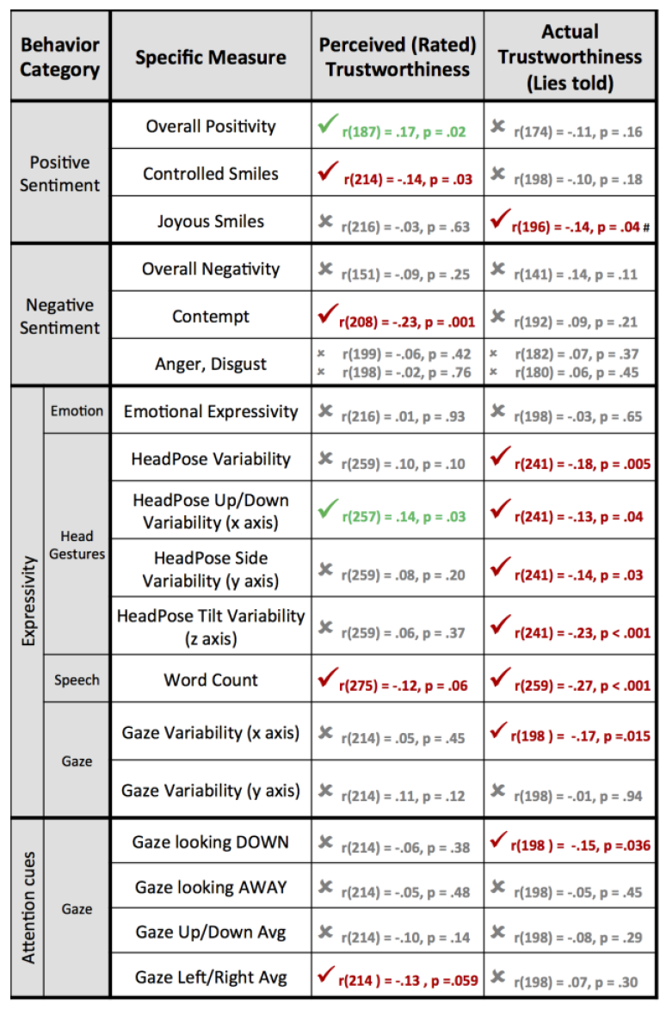
Example
Analyze data

Slide 47
Example
Can also combine NHST with “data driven” (bottom up) approach such as classification

Slide 48
Possible Pre-processing Steps
Feature generation: formulating new features based on initial given features
E.g.: Eliminating morphological variation from a document
Initial features: investor, investors, investing, invested,
Generated feature: “invest”
Feature construction: creating new features by combining other features
E.g.: Characterizing animal behaviors
Initial features: movement, sitting, laying down, eating, running, sleeping,…
Constructed features: “hunting” = running followed by eating
Feature selection: decision on what subset of the initial given features should be used
E.g.: Characterizing customer music preferences
Initial features: age, height, favorite artist, car brand, address,…
Selected features: age, address, favorite artist
Notes:
Initial features – had that word or not
generated feature – had any with “in
Feature generation – any of initial features counts as generated feature (e.g., root “invest” is new generated feature denoting use of any of those related words)
Feature construction – combining, so must have one feature AND another feature to have constructed feature (run then eating)
vest”

Slide 49
Example
Pre-process data
Feature generation: formulating new features based on initial given features
Initial features: happy, angry, sad, surprised, fear
Generated feature: “Expressivity”
Feature construction: creating new features by combining other features
Control smile if AU 12 + any “control” muscle movements (e.g., dimples -AU14-, lip corner depressing -AU15-, chin raising –AU17-, lip tightening –AU23- and lip pressing -AU 24)
Joyous smile if AU 12 + any “authentic” muscle movements (e.g., cheek raising –AU6-, mouth openness –AU25- and jaw dropping -AU26)
Feature selection: decision on what subset of the initial given features should be used
LASSO in the training set for automatic feature selection
Notes:
Initial features – showed that expression or not
generated feature – had any expression, or count of number of ANY of those expressions
Feature generation – any of initial features counts as generated feature (e.g., root “invest” is new generated feature denoting use of any of those related words)
Feature construction – combining, so must have one feature AND another feature to have constructed feature (run then eating)

Slide 50
Example
Classifiers
Liar or not
Perceived by opponent as dishonest or honest
Facial features, especially smile, predicted perception
Multimodal approach is better predictor of actual lying
Word count is used accurately
Analyze data

Slide 51

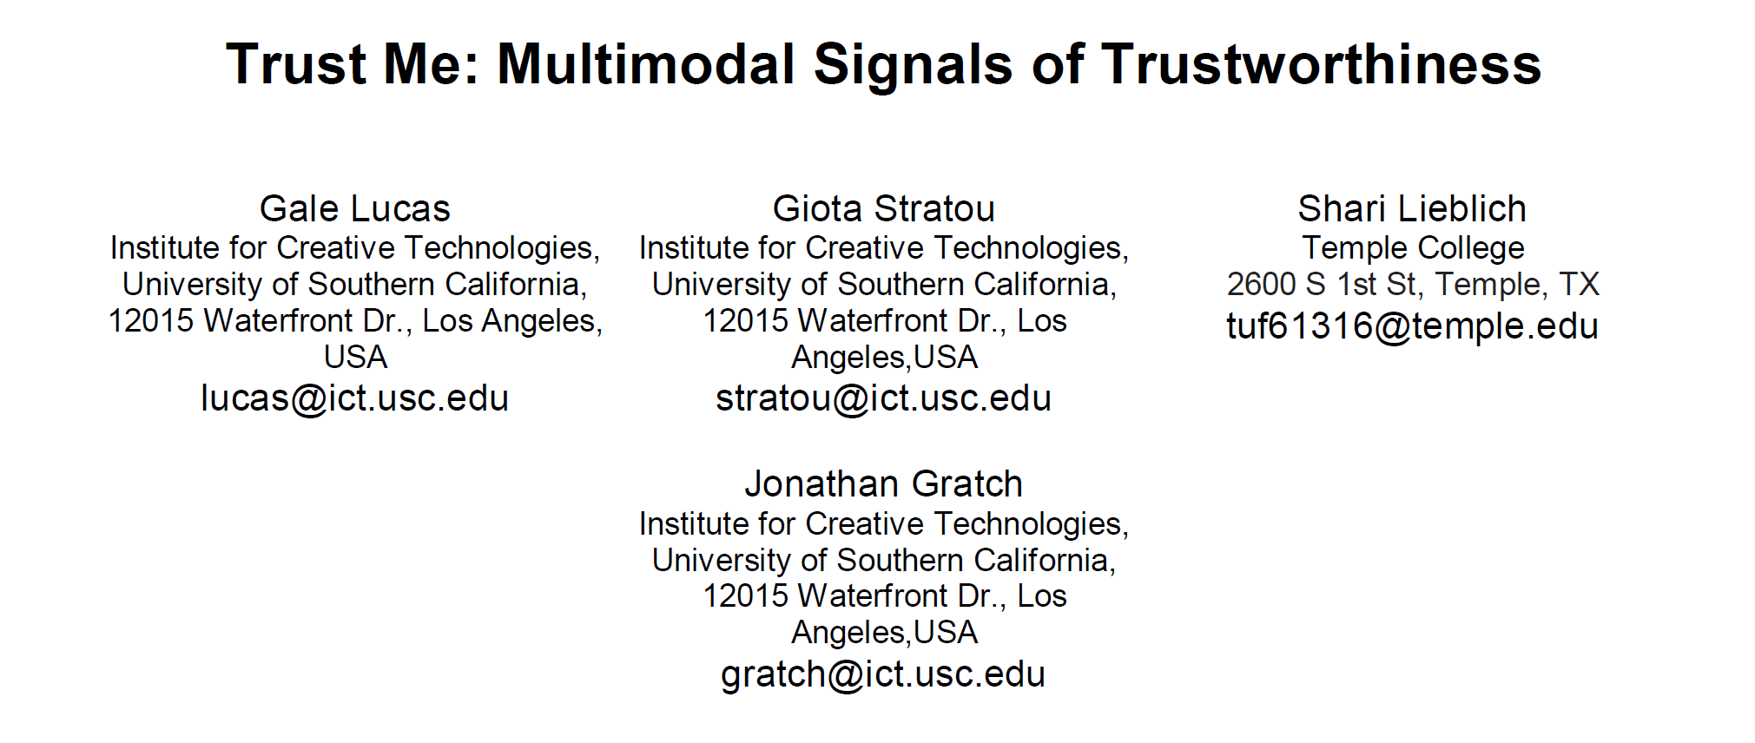
Example
International Conference on Multimodal Interaction
Present results
Publish data

Slide 52
Example
Can also use “data driven” (bottom up) approach such as classification to prepare data for NHST

Slide 53
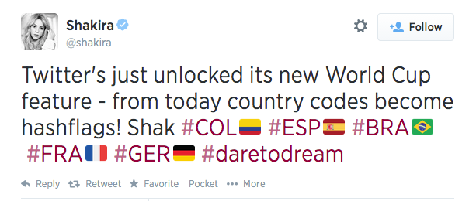
Example:
Collecting Twitter Data
All tweets (with country code hashtags for current game) were recorded for the 2014 World Cup games

Slide 54
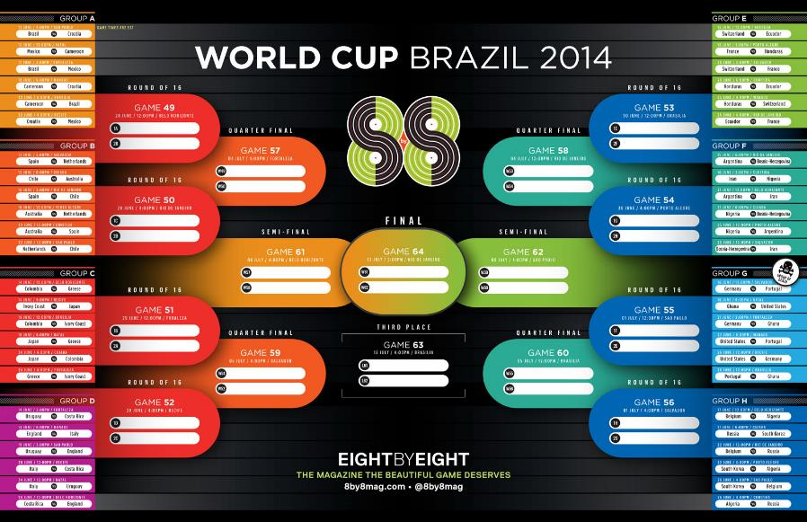
Collecting Twitter Data
Notes:
64 games --- 32 countries, each has to play 3 games in group stage before making it the last 16, quarter-finals, semi-finals, third-place play-off and final

Slide 55

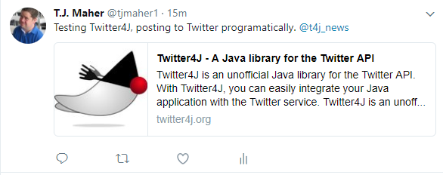

Collecting Twitter Data
Recorder
Notes:
java-based recorder employing Twitter Streaming API and Twitter4J Java library

Slide 56

Collecting Twitter Data
#TeamA
#TeamB
Recorder
Recorder
Notes:
java-based recorder employing Twitter Streaming API and Twitter4J Java library

Slide 57
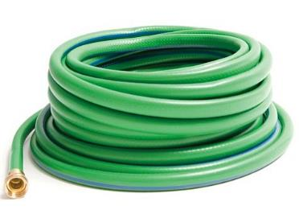

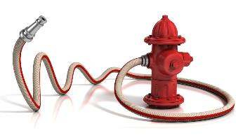
Collecting Twitter Data
1%
Notes:
Publically available, 1% of all world-wide tweets at any moment
Data imputing to extrapolate number of tweets
During more popular games, this restriction limited the number of tweets we could capture, so had to adjust for what we lost in our estimates

Slide 58
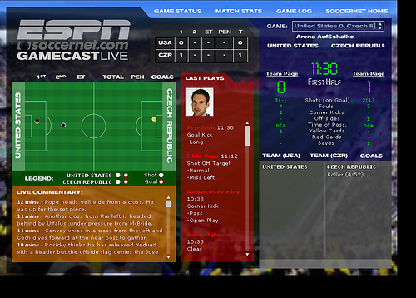
Collecting Twitter Data
ESPN.com's GameCast provided a timeline of all shots, goals, penalties, substitutions, etc.
Notes:
Other data we had to extract and align!

Slide 59
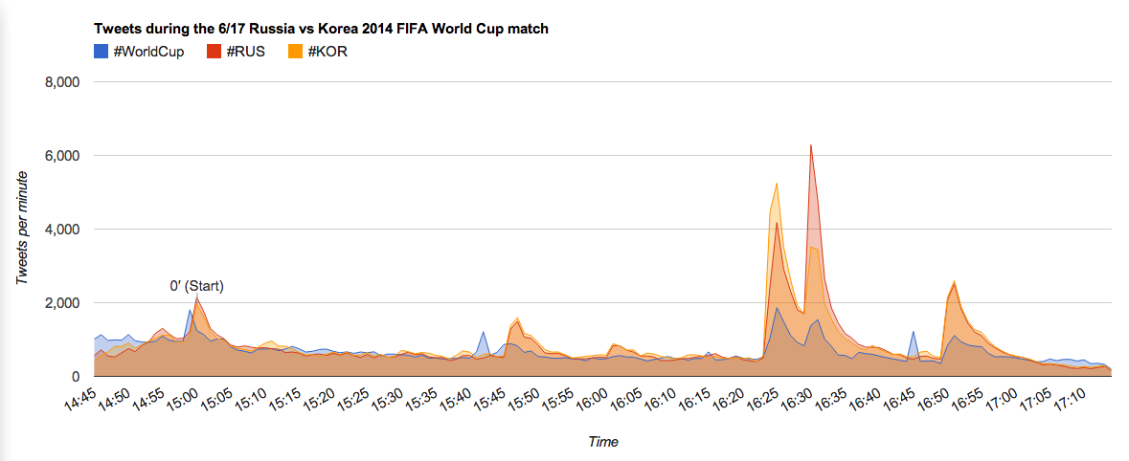
#RUS vs #KOR Tweets
RUS goal
KOR goal
End of game
Halftime
Notes:
Visualization!
Time series data!

Slide 60
Collecting Twitter Data
SAIL method for sentiment analysis of tweets (Malandrakis et al., 2014)
Positive
Negative
Neutral
Come on #USA Would love to see 'em get through
This game is agonizing, pick it up yanks!!! #usa
I think patriotism comes out in all of us when there's a big game like this. #USA

Slide 61

Collecting Twitter Data
Prediction from Sports economics: games that are “blowouts” will be more boring and therefore less attended
Notes:
Theory from sports economics - Trying to predict when will people STAY AT A GAME – if it becomes a close game, people will want to stay cause they feel good about the game
ALTERNATIVELY, If it becomes clear who’s going to win (when they didn’t know before), people should leave BECAUSE THEY DON’T FEEL AS GOOD ABOUT THE GAME
Had very coarse way of looking at it before: they bought a ticket but when they saw the betting odds (its going to be a blowout), they didn’t show up (not go through turnstile)
then in 2010, looked at how many people stopped watching if it became a blowout

Slide 62
#RUS vs #KOR Tweets
RUS goal
KOR goal
End of game
Halftime
Final game score: 1–1

Slide 63
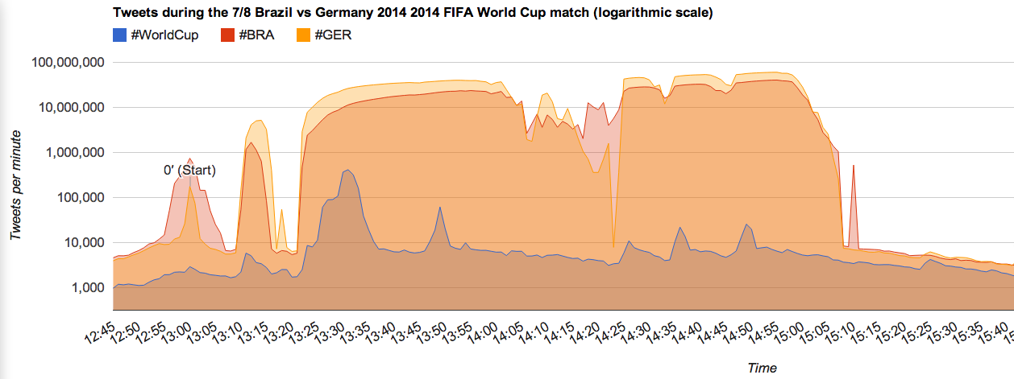
#BRA vs #GER Tweets
more goals by GER
BRA goal
more goals by GER
End of game
GER goal
Halftime
Final game score: 1–7
Notes:
And a game that was not 1 to 1

Slide 64
Collecting Twitter Data
Prediction from Sports economics: games that are “blowouts” will be more boring and therefore less attended
Notes:
Theory from sports economics - Trying to predict when will people STAY AT A GAME – if it becomes a close game, people will want to stay cause they feel good about the game
ALTERNATIVELY, If it becomes clear who’s going to win (when they didn’t know before), people should leave BECAUSE THEY DON’T FEEL AS GOOD ABOUT THE GAME
Had very coarse way of looking at it before: they bought a ticket but when they saw the betting odds (its going to be a blowout), they didn’t show up (not go through turnstile)
then in 2010, looked at how many people stopped watching if it became a blowout

Slide 65
Today’s Topics
Consuming statistical results
Ensuring internal validity
Data lifecycle

